Slide 1
Erasmus+ Capacity Building projects
in the field of Higher Education
Call 2015
Financial management of the Grant
  Project Representatives Meeting
Brussels, 27-28 January 2016

Slide 2
  Outline of the presentation:
  1) General financing principles
  2) Actual costs, rules and budget headings
  3) Unit costs, rules and budget headings
  4) Managing the Grant
  5) How to report
  6) Final grant
  NB: please note that this document has no legal value

Slide 3
ANNEX III of Grant Agreement
Estimated budget of the Action
Maximum Grant contribution to the project costs
 | EUR
I STAFF COSTS | 340.000
II TRAVEL COSTS | 150.000
III COSTS OF STAY | 150.000
IV EQUIPMENT | 160.000
V SUBCONTRACTING | 50.000
TOTAL GRANT (total I-V) | 850.000

Slide 4
  Outline of the presentation:
  1) General financing principles
  2) Actual costs, rules and budget headings
  3) Unit costs, rules and budget headings
  4) Managing the Grant
  5) How to report
  6) Final grant

Slide 5
  1) General financing principles
  Funding rule
  Financing approaches
  Budget categories and ceilings
  Budget transfer

Slide 6
Funding rule
Amount of the Grant
≠
Total costs of the project

Slide 7
Funding rule
Co-funding principle
Grant (combination of actual costs/unit costs):
Calculated so as to require co-funding to implement the project
Co-funding:
- other expenses (e.g. overhead costs) or higher expenditure than unit cost values
- not taken into account for the calculation of the Grant
- requested with final report for information purposes

Slide 8
Financing approaches of the grant
Actual costs: budget headings Equipment and Subcontracting
Unit Costs: budget headings Staff costs, Travel costs and Costs of stay

Slide 9
Budget Categories/Headings and ceilings
Staff costs | Max 40% of grant (Art I.3 of GA)
Travel costs | N/A
Costs of stay | N/A
Equipment | Max 30% of grant (Art I.3 of GA)
Sub-contracting | Max 10% of grant (Art I.3 of GA)

Slide 10
Budget Categories/Headings and ceilings
example
Budget headings | EUR | %
I STAFF COSTS | 340.000,00 | 40%
II TRAVEL COSTS | 150.000,00 | 17,5%
III COSTS OF STAY | 150.000,00 | 17,5%
IV EQUIPMENT | 160.000,00 | 19%
V SUBCONTRACTING | 50.000,00 | 6%
TOTAL GRANT (total I-V) | 850.000,00

Slide 11
Modification to the budget
Possibility to adjust the estimated budget (Annex III) :
1) Increase up to 10% (even above the ceilings for staff, equipment and subcontracting)
→ no prior authorization
2) Increase > 10% → Legal amendment is needed
The ceilings (for staff, equipment and subcontracting) cannot be exceeded.

Slide 12
Modification to the Budget
Example 1 = NO legal amendment
 | EUR | Budget transfer | % of budget heading | result | % of total grant
I STAFF COSTS | 340.000 |  |  | 340.000 | 40%
II TRAVEL COSTS | 150.000 |  |  | 150.000 | 17,5%
III COSTS OF STAY | 150.000 | -10.000 |  | 140.000 | 16,5%
IV EQUIPMENT | 160.000 | +10.000 | +6% of 160.000 | 170.000 | 20%
V SUBCONTRACTING | 50.000 |  |  | 50.000 | 6%
TOTAL GRANT (total I-V) | 850.000 |  |  | 850.000

Slide 13
Modification to the Budget
Example 2 – legal amendment needed
 | EUR | Budget transfer | % of budget heading | result | % of total grant
I STAFF COSTS | 340.000 |  |  | 340.000 | 40%
II TRAVEL COSTS | 150.000 |  |  | 150.000 | 17,5%
III COSTS OF STAY | 150.000 | -10.000 |  | 140.000 | 16,5%
IV EQUIPMENT | 160.000 |  |  | 160.000 | 19%
V SUBCONTRACTING | 50.000 | +10.000 | +20% of budget heading | 60.000 | 7%
TOTAL GRANT (total I-V) | 850.000 |  |  | 850.000

Slide 14
Modification to the Budget
Example 3 – Modification NOT ACCEPTED !!!!!
 | EUR | Budget transfer | % of budget heading | result | % of total grant
I STAFF COSTS | 340.000 | +45.000 | +13% of budget heading | 385.000 | 45,5%
II TRAVEL COSTS | 150.000 |  |  | 150.000 | 17,5%
III COSTS OF STAY | 150.000 | -20.000 |  | 130.000 | 15%
IV EQUIPMENT | 160.000 |  |  | 160.000 | 19%
V SUBCONTRACTING | 50.000 | -25.000 |  | 25.000 | 3%
TOTAL GRANT (total I-V) | 850.000 |  |  | 850.000

Slide 15
  Outline of the presentation:
  1) General financing principles
  2) Actual costs, rules and budget headings
  3) Unit costs, rules and budget headings
  4) Managing the Grant
  5) How to report
  6) Final grant

Slide 16
  2) Actual costs, rules and budget headings
  Definition
  Eligible costs
  Ineligible costs
  Exchange rate
  Tendering procedure
  Budget headings : equipment
  Budget heading : subcontracting

Slide 17
Definition
Expenses actually incurred
Need to be duly documented and justified with the corresponding level of cost incurred
Example:
Reported cost for the project (laptops) of 1.500 EUR
=
Supporting document (invoice, proof of payment…) for 1.500 EUR

Slide 18
Article II.19 Grant Agreement
Incurred during the eligibility period
Foreseen in the application/budget
In connection with the action and necessary for project implementation
Identifiable, verifiable, recorded in accounting records of the beneficiary
Comply with requirements of applicable tax and national legislation
Reasonable, justified, complying with principle of sound financial management, in particular regarding economy and efficiency
Eligible Costs

Slide 19
Ineligible Costs
Articles I.10.4/II.19.4 of Grant Agreement
Non exhaustive list:
- equipment such as: furniture, motor vehicles, alarm systems
- costs linked to the purchase of real estate
- activities not carried out in the project beneficiaries' country (see Annex IV), unless prior authorisation
- in kind contribution
- excessive or reckless expenditure
- deductible VAT (unless beneficiary can prove he is unable to recover it according to the national tax authority)

Slide 20
Exchange rate
Transactions ≠ EUR must be converted and reported in
EUR in the Financial Statement of the final report
Which exchange rate should be applied?
From start of eligibility period until date of receipt of second pre-financing: rate of month in which the coordinating institution received the first pre-financing
From date of receipt of second pre-financing until end of eligibility period: rate of month in which the coordinating institution received the second pre-financing
Rate to apply: monthly rate established by the Commission: http://ec.europa.eu/budget/inforeuro
Example:
1st Pre-financing: 23 Dec 2015 – 2nd Pre-financing: 22 Nov 2016
Invoice date: 09 January 2016 Applicable monthly rate: December 2015

Slide 21
Tendering procedure
The beneficiary shall apply the tendering procedure for the purchase of any kind of goods or services WHENEVER the amount of the purchase/sub-contract is between EUR 25.000 and 134.000
Principles of transparency, equal treatment of potential contractors,
avoiding conflicts of interests
Criterion for selection of offer: best value for money
If value of purchase/sub-contract > EUR 134.000:
national legislation applicable
Split purchase/sub-contract into smaller contracts below the threshold to avoid a tendering procedure NO!

Slide 22
Equipment
- Relevant to the objectives of the project
Examples: (e-)books and periodicals, fax machines, photocopying machines, computers, software, machines and equipment for teaching purposes etc
- Total purchase cost (not depreciation)
- Exclusively for Partner Country Higher Education Institutions
- Installed as soon as practically possible
- Recorded in inventory of institution where it is installed
Not eligible: furniture, motor vehicles, telephones, mobile phones, alarm systems and anti-theft systems etc
- Labelled with E+ stickers
Not foreseen in the application/budget? Prior written authorisation from Agency

Slide 23
Equipment – Supporting documents
To keep with project accounts (may be requested in case of financial check):
  Invoice(s) and bank statement(s)
  > EUR 25.000 < EUR 134.000: tendering procedure and three quotations from different suppliers
  > EUR 134.000: tendering procedure according to national legislation
  Proof that equipment is recorded in inventory of the institution
To send with Final Financial statement:
  Equipment with value > EUR 25.000, copy of invoice(s) and competitive offers
  Any prior authorisation from the Agency

Slide 24
Subcontracting
Implementation of specific tasks, by third party, to which a contract is awarded by one/several beneficiaries
Specific, time-bound, project-related tasks which cannot be performed by Consortium members. It includes self-employed / free-lance experts
Examples (provided that not carried out by beneficiaries' staff):
  Evaluation activities/auditing (Audit Certificate on Financial Statement)
  IT courses, Language courses
  Printing, publishing and dissemination activities
  Translation services
  Web design and maintenance
  Logistic support for the organisation of events
Not foreseen in the application/budget? Prior written authorisation from Agency
NO project-management related tasks

Slide 25
Supporting documents
To keep with project accounts (may be requested in case of financial check):
  Invoices, subcontracts and bank statements
  > EUR 25.000 < EUR 134.000: tendering procedure and three quotations from different suppliers
  > EUR 134.000: tendering procedure applied according to national legislation
  Tangible outputs/products
  Travel activities of subcontracted service provider: copies of travel tickets, boarding passes, invoices and receipts
To send with Final Financial statement:
  Total value of subcontract > EUR 25.000: copies of subcontract, invoice and competitive offers
  Any prior authorisation from the Agency

Slide 26
  Outline of the presentation:
  1) General financing principles
  2) Actual costs, rules and budget headings
  3) Unit costs, rules and budget headings
  4) Managing the Grant
  5) How to report
  6) Final grant

Slide 27
3) Unit costs, rules and budget headings
  Definition
  Examples
  Budget heading: staff costs
  Budget heading: travel costs and costs of stay

Slide 28
Definition
  Fixed contribution (not fractioned) multiplied by number of units
  "Triggering event" activities implemented/outputs produced
  No need to justify level/amount of costs incurred
  Activities implemented during the eligibility period
  In case of financial control/audit declared unit costs supported with proof demonstrating that activities implemented
  If activity/output not accepted (e.g. not supported by concrete evidences) no corresponding unit costs is granted
  Examples: travel activity for teaching not sufficiently documented (e.g. with presence or participation lists, or with a certificate of attendance)

Slide 29
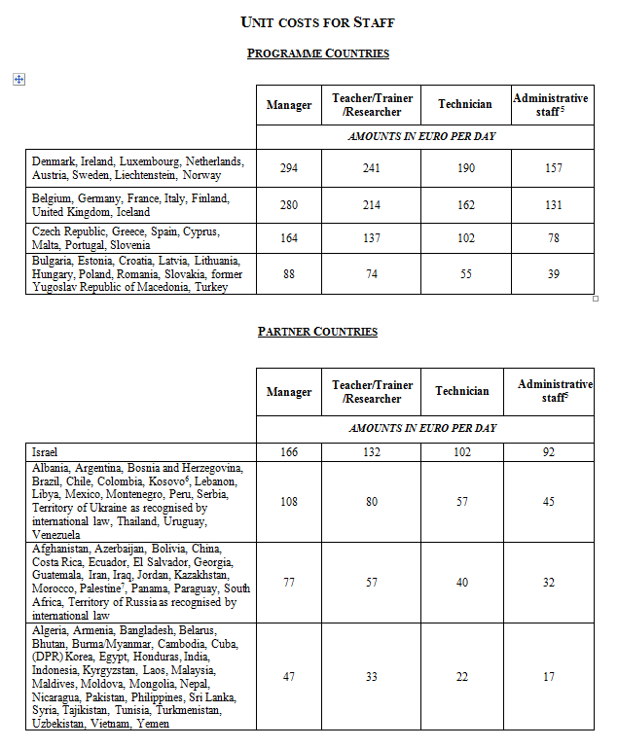
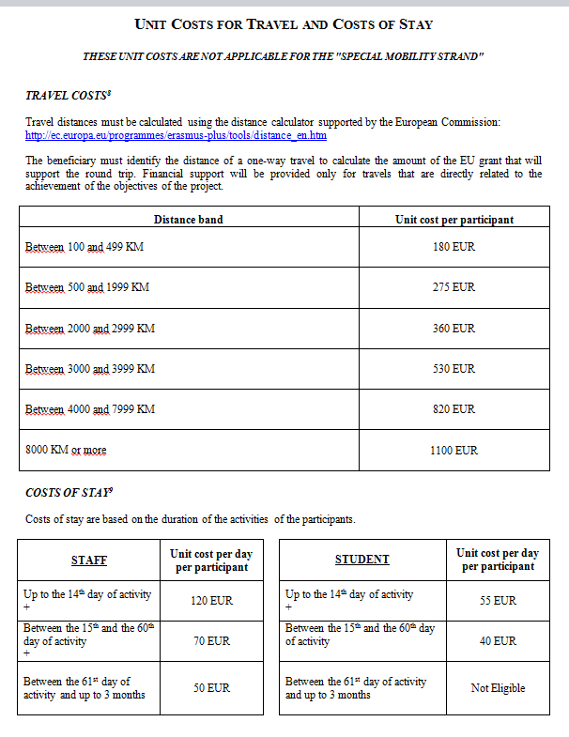
CBHE units

Slide 30
Staff Costs
Performing tasks necessary to achievement of the project
Formal employment relationship
Calculation of the grant 2 variables: staff category and country in which staff member is employed
Each unit cost corresponds to an amount in Euro per working day per staff
Categories: Managers/Researchers, Teachers and trainers/Technical staff /Administrative staff
Staff category: work performed, not status of individual
Unit cost: country in which staff is employed, independently of where tasks are executed

Slide 31
Staff Costs
Example: a staff employed in Lithuania performing teaching activity for 3 days
222 Euro (3 unit costs of 74 Euro each)
Calculation of grant:
  based on application of unit costs and independent from actual remuneration (defined in the Partnership Agreement)
  obtained by multiplying unit cost (corresponding to category of country and staff) by number of working days spent on the project per staff member
One working day defined according to applicable national legislation/ institutional practice.
Declared working days per individual may not exceed 20 days per month or 240 days per year

Slide 32
Staff Costs - Supporting Documents
To keep with project accounts (requested in case of financial check):
  Staff Convention for each person employed
  Time-sheets (attached to each staff convention), indicating number of days worked for corresponding month/year, description of tasks , outputs produced and related work package
  Any evidence allowing to verify that declared workloads correspond to actual activities/outputs (e.g. attendance lists for lectures given, tangible outputs / products, salary slips, etc.)
  Employment contract
To send with Final Financial statement:
  Any prior authorisation from the Agency

Slide 33
Travel costs and Costs of Stay
Rules for Special Mobility Strand are defined in separate Guidelines
  Staff/students participating in activities related to the achievement of the project
  Unit costs to apply 3 variables: travel distance (for travel costs), duration for costs of stay and type of participant
  Prior authorisation for activities not taking place in countries represented in the partnership
  Prior authorisation for activities not described in the Guidelines
Who may benefit?
Staff
  Under contract with beneficiary institutions and involved in the project
  Travels intended for the activities listed in the Guidelines
  Duration: Max. 3 months
  Students
  Registered in one of the beneficiary institutions
  Targeted mainly at Partner Country students and intended for activities listed in the Guidelines (overview table)
  Duration: Min. 2 weeks – Max. 2 months (Max. 1 week for short term activities linked to the management of the project)

Slide 34
Travel and Costs of Stay - Supporting documents
Justification for the following elements:
- Journeys actually took place
- Journeys connected to specific and identifiable project-related activities
To be retained with project accounts:
Individual Travel Report + Supporting documents (e.g. travel tickets, boarding passes, invoices, receipts, proof of attendance in meetings and/or events, agendas, tangible outputs/products, minutes of meetings)
To be provided with Final Financial statement:
Any prior authorisation from the Agency

Slide 35
Travel costs: specific rules
  Staff/students from place of origin (home institution within the partnership) to venue of the activity and return
  Carried out in project beneficiaries' countries - Exceptions must be authorised
  How the grant is calculated?
  For each participant and for each travel unit cost corresponding to applicable distance band
  Each unit cost corresponds to a fixed amount in Euro per travel per person
  1) Check travel distance of a one-way travel http://ec.europa.eu/programmes/erasmus-plus/tools/distance_en.htm
  2) Apply corresponding unit cost
  Each unit cost contributes to costs of travel for the round trip, regardless of the expenses actually incurred

Slide 36
Travel costs: specific rules
  Example: A participant from Madrid (Spain) takes part in activity in Rome (Italy)
  distance from Madrid to Rome (1365 Km) + apply unit cost (distance band 500/1999 Km): fixed contribution of 275 Euro covering travel from Madrid to Rome and return
  If place of departure different from place of home institution: prior authorisation
  Circular travels (A to B, B to C and return A):
  sum of:
  unit cost corresponding to distance band from A to B
  +
  unit cost corresponding to distance band from B to C
  Final travel not taken into account for the calculation of the grant
  Not applicable to air travels with stopover(s)
  No financial contribution for travels < 100 km (costs of stay eligible)

Slide 37
Cost of stay specific rules
  Staff/students for activities outside city of participant's home institution
  Activities in project beneficiaries' countries. Exception must be authorised
Unit costs for staff unit costs for students
Unit costs can only be claimed if there is at least 1 overnight stay
For each staff: unit cost corresponding to the duration of the activities (in days), up to 14th day/between 15th and 60th day/between 61st day and up to 3 months
For each student: unit cost corresponding to duration of activities (in days), up to 14th day/between 15th and 60th day
Each unit cost corresponds to a fixed amount in Euro per day per participant
How to apply unit costs?
(1) Identify the duration in days of the activity (including the travel from their place of origin to the venue of the activity and vice-versa) (2) Number of unit costs = numbers of days of activity performed.
Each unit cost contributes to costs of stay regardless of expenses actually incurred

Slide 38
Cost of stay specific rules
Examples:
A staff from Paris (France) takes part in activity in Brussels (Belgium) during 2 days:
Max. 2 unit costs of 120 Euros each (TOTAL: 240 Euros)
A staff from Paris (France) takes part in activity in Brussels (Belgium) during 20 days:
Max. 14 unit costs of 120 Euros each + 6 unit costs of 70 Euros each (TOTAL: 2.100 Euros)
A student from Paris (France) takes part in activity in Berlin (Germany) during 22 days:
Max. 14 unit costs of 55 Euros each + 8 unit costs of 40 Euros each (TOTAL: 1.090 Euros)

Slide 39
  Outline of the presentation:
  1) General financing principles
  2) Actual costs, rules and budget headings
  3) Unit costs, rules and budget headings
  4) Managing the Grant
  5) How to report
  6) Final grant

Slide 40

Grant management cycle | UNIT COST | ACTUAL COSTS
Grant allocation | Based on estimated work programme | Based on the estimated budget
Grant Implementation | Beneficiary's own FINANCIAL "RECIPE" | Record costs actually incurred
Grant justification | Based on activities actually implemented | Based on costs actually incurred

Slide 41
TRAVEL COSTS
4 meetings, 25 participants each, destination 2500 km =360 €
 | EACEA Unit costs | Real costs | Reimbursed to project staff | Balance (UC-RC)
Travel 1 | 360 | 310 | ?
Travel 2 | 360 | 520 | ?
Travel 3 | 360 | 200 | ?
… | … | … | …
Travel 100 | 360 | 300 | ?
scenario 1 TOTAL | 36.000 | 37.000 |  | -1.000
scenario 2 TOTAL | 36.000 | 35.000 |  | +1.000

Slide 42
Consortium management of unit costs
Consortia have to find the most appropriate method to manage internally the accountancy.
Transparency in the methodology.
Formalisation of the methodology and the Partnership Agreement.
Acceptance of this methodology by the Consortium.

Slide 43
  Outline of the presentation:
  1) General financing principles
  2) Actual costs, rules and budget headings
  3) Unit costs, rules and budget headings
  4) Managing the Grant
  5) How to report
  6) Final grant

Slide 44
5) How to report
  Financial Reporting
  Supporting documents

Slide 45
  Financial Reporting
  Final financial statement main financial reporting tool:
  - Financial reporting with final report (request of final grant)
  - Financial reporting during project implementation (monitoring budget consumption)
  Reporting of Actual costs
  Equipment and Sub-contracting: reporting of costs incurred (based on costs actually incurred, e.g. amounts corresponding to invoices, contracts, etc.)
  Reporting of Unit costs
  Staff, Travel costs and Costs of stay: reporting of unit costs (based on information for calculation of units, e.g. km, working or travelling days, etc.)

Slide 46
Supporting Documents
  Originals kept by beneficiaries. Copies kept by coordinator and submitted with Final report, when requested
  In case of financial checks/audits, or if doubts on implementation of any particular activity or expenditure, the Agency may request corresponding supporting documents
  Quality of documentation
  For all grants:
  Audit Certificate ("Report of Factual Findings on the Final Financial Report – Type II") must be sent with the Final report

Slide 47
Reimbursement basis | Budget Headings | Documents to retain with project accounts | Documents to be sent with the Final report
ACTUAL | Equipment | Invoices Bank statements Tendering procedure for expenses exceeding 25.000€ Proof that the equipment is recorded in the inventory of the institution | Invoices and three quotations from different suppliers for expenses exceeding 25.000€ Any prior authorisation from the Agency
 | Subcontracting | Subcontracts Invoices Bank statements Tendering procedure for expenses exceeding 25.000€ Tangible outputs/products* | Subcontracts, invoices and three quotations from different suppliers for expenses exceeding 25.000€ Any prior authorisation from the Agency
UNIT | Staff | Formal employment contract Staff convention Time sheets Agendas* Attendance / Participant lists* Tangible outputs/products* Minutes of meetings* | No supporting documents should be sent with the Final report, except for any prior authorisation from the Agency
 | Travel and Costs of Stay | Individual Travel Report (ITR) Invoices, receipts, boarding passes* Agendas* Attendance / Participant lists* Tangible outputs/products* Minutes of meetings* | No supporting documents should be sent with the Final report, except for any prior authorisation from the Agency
For all grants, a Certificate on the action's financial statements and underlying accounts ("Report of Factual Findings on the Final Financial Report – Type II") must be sent with the Final report (see Annex VII of the Agreement). * Example of supporting documents

Slide 50
  Outline of the presentation:
  1) General financing principles
  2) Actual costs, rules and budget headings
  3) Unit costs, rules and budget headings
  4) Managing the Grant
  5) How to report
  6) Final grant

Slide 51
6) Final grant
  Calculation of the final grant
  Practical examples

Slide 52
Calculation of the Final Grant
  The grant may not exceed the maximum amount authorised in the Agreement (Article I.3 and Article II.25.2)
  Final grant: determined following examination of financial statements and eligibility of activities implemented and declared expenses. Declared unit costs/expenses identified as ineligible will be deducted from the total amount declared
  Balance = final grant – pre-financings – penalties
  Penalties related to the implementation of the action described in the contractual workshop

Slide 53
examples (1 of 2)
All costs eligible no penalties |  | Total declared expenditure
 | Grant awarded | = grant awarded | < total grant awarded UNDERSPENT | > total grant awarded OVERSPENT
I STAFF COSTS | 340.000 | 340.000 | 290.000 | 330.000
II TRAVEL COSTS | 150.000 | 150.000 | 165.000 | 150.000
III COSTS OF STAY | 150.000 | 150.000 | 165.000 | 160.000
IV EQUIPMENT | 160.000 | 160.000 | 170.000 | 170.000
V SUBCONTRACTING | 50.000 | 50.000 | 40.000 | 50.000
TOTAL GRANT (total I-V) | 850.000
TOTAL DECLARED |  | 850.000 | 830.000 | 860.000
FINAL GRANT |  | 850.000 | 830.000 | 850.000

Slide 54
examples (2 of 2)
All costs eligible no penalties |  |  | Total declared expenditure |  | Total declared expenditure
 | Grant awarded | % TOTAL GRANT | = total grant awarded | % TOTAL GRANT AWARDED | = total grant awarded | % TOTAL GRANT AWARDED
I STAFF COSTS | 340.000 | 40% | 374.000 | 44% | 385.000 | 45,5%
II TRAVEL COSTS | 150.000 | 17,5% | 150.000 |  | 150.000 | 17,5%
III COSTS OF STAY | 150.000 | 17,5% | 100.000 |  | 130.000 | 15%
IV EQUIPMENT | 160.000 | 19% | 160.000 |  | 160.000 | 19%
V SUBCONTRACTING | 50.000 | 6% | 0 |  | 25.000 | 3%
TOTAL GRANT (total I-V) | 850.000
TOTAL DECLARED |  |  | 784.000 |  | 850.000 | (- 11.000 €)
FINAL GRANT |  |  | 784.000 |  | 839.000

Slide 55

QUESTION NOT ANSWERED?
Please contact the E+CBHE team
EACEA-EPLUS-CBHE-PROJECTS@ec.europa.eu
Don't forget to mention your project number!

Slide 56


